Slide 1
Text Analysis of Technical Support Documents
Stephen Kappel
May 15, 2014
COMS W4721

Slide 2
Motivation
I’m a Business Analyst for CA Technologies’ Customer Success & Support.
Plentiful text at our fingertips:
Support tickets
Forum posts
Searches against our knowledge base
Technical documentation
Log files
Opportunities:
Intelligently “route” issues (support tickets and forum posts)
Find previously solved issues related to a newly reported issue
Identify areas needing focus (documentation or product-related)

Slide 3
Overview
Data source: MSDN forums for SQL Server and SharePoint
48 forums
73,822 threads created in 2013
Title and question text
Supervised learning
Predict the forum category (product) or forum from thread’s text
Unsupervised learning
Find most similar documents
Find latent topics

Slide 4
Getting Started
Vocabulary creation
Removed stop words
Removed extremely rare words
Training, validation, and test datasets
GUIDs!
Text cleansing
lower()
Removed non-alphabetical characters

Slide 5
Forum Categories Classification
Create a document-vocab matrix with a row for each training doc and a column for each word in the vocabulary. Each value is the count of occurrences of a particular word in a particular document.
For each forum category, sum all associated rows/docs in the document-vocab matrix to get a category vector.
For the document to be classified, build a document vector. (The same as the document-vocab matrix but with only one row.)
Score the similarity between the document and each forum category by finding the dot product between the document vector and each category vector.
Assign the document to the category with the highest similarity.

Slide 6
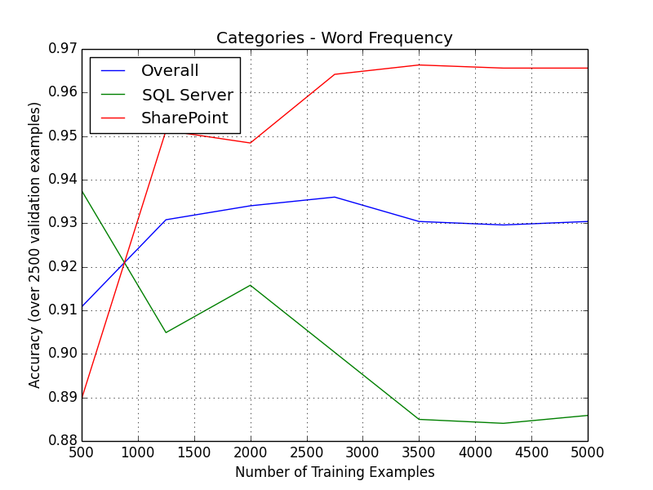
Initial Results

Slide 7
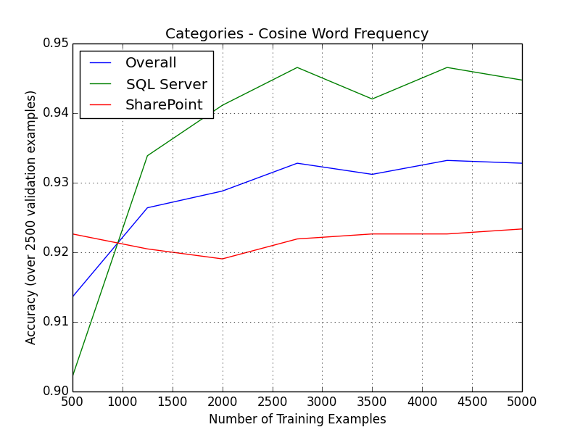
Cosine Similarity
Divide the dot product by the product of the norms.

Slide 8
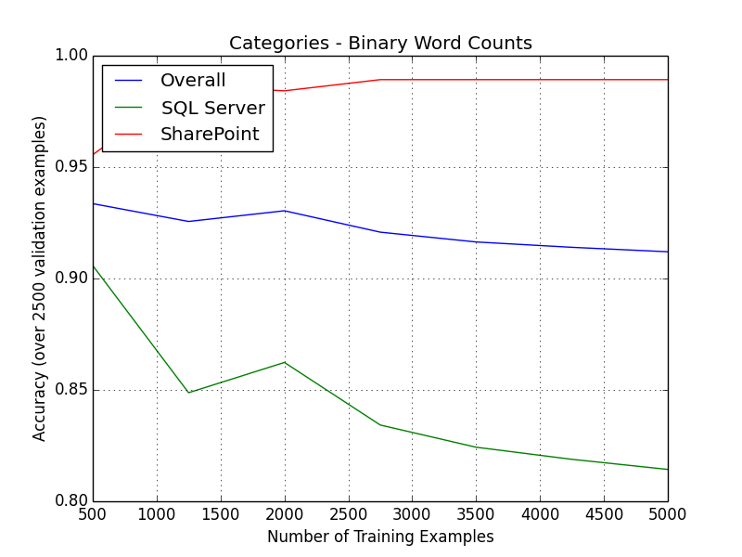
Binary Word Counts
In document-vocab matrix and document vector, use only 0s and 1s to indicate whether or not a word is found in a document.

Slide 9
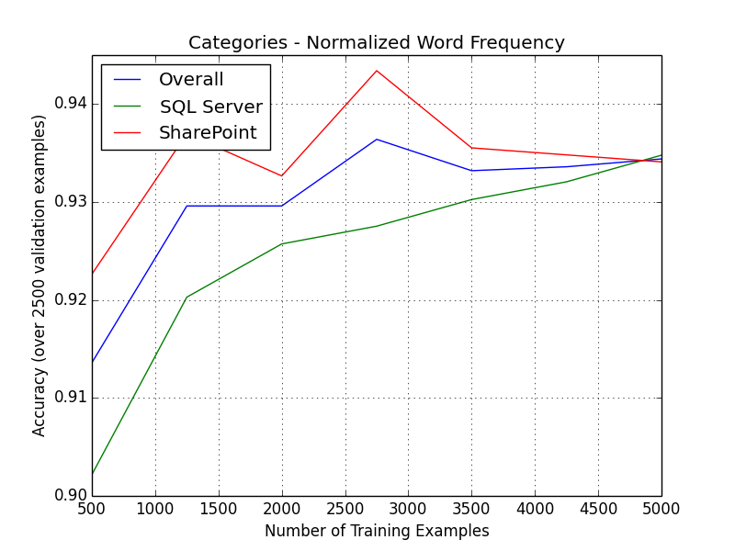
Normalization
Scale each category vector such that all its values add to 100.
This prevents bias toward SharePoint.

Slide 10
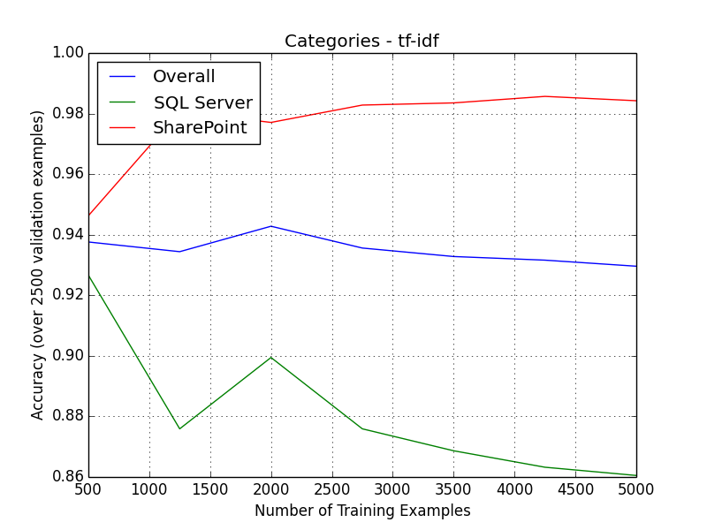
Term Frequency – Inverse Document Frequency (tf-idf)
Divide each value in the category vectors by the number of documents containing that word.

Slide 11
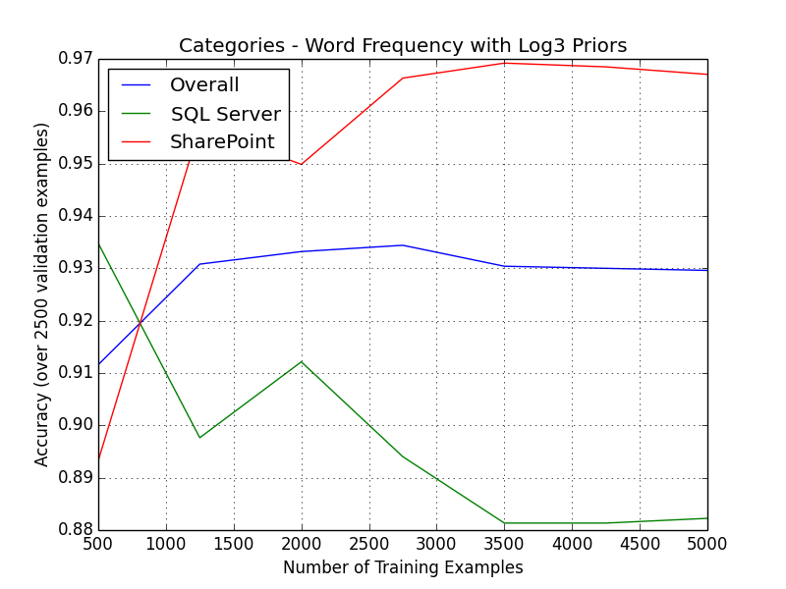
Priors
When finding similarity scores, include a factor to give higher score to more frequent forum categories.

Slide 12
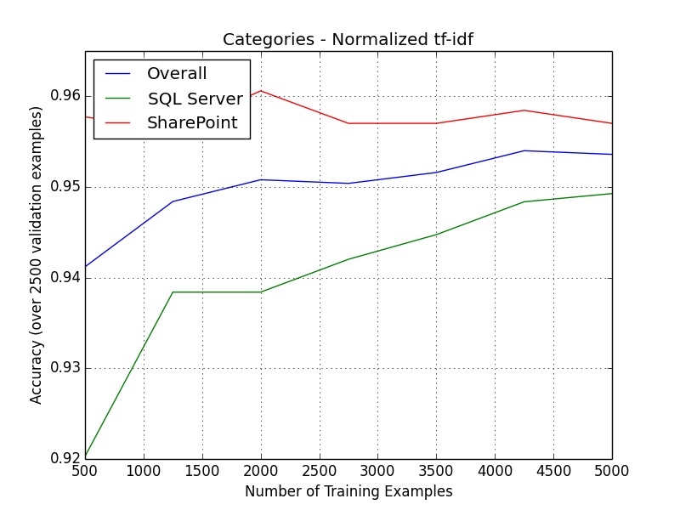
Winning Combination
Plot against validation dataset:
Results when tested against test dataset:
 | SharePoint | SQL Server | Overall
Correct class | 7,304 | 5,865 | 13,169
Incorrect class | 450 | 307 | 757
Accuracy | 94.2% | 95.0% | 94.6%

Slide 13
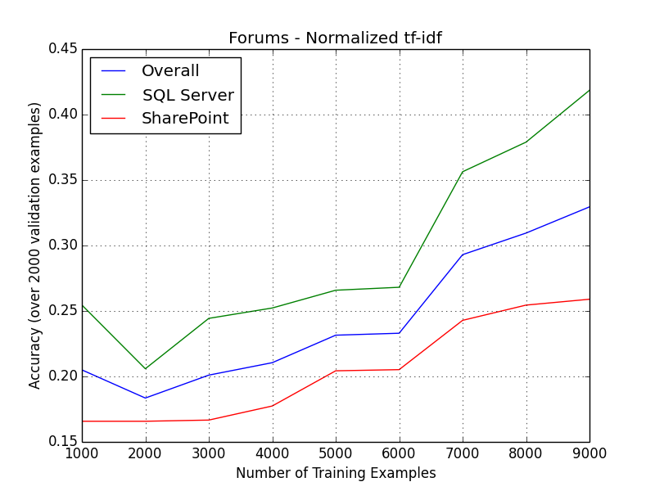
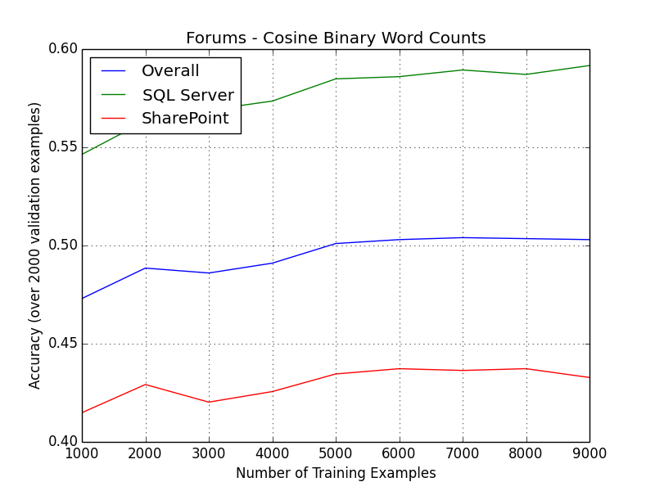
Forums Classification
Repeat with forums rather than forum categories
2 forum categories → 38 forums
Normalized tf-idf doesn’t do so well…
Cosine binary word counts performs the best, and had 49.6% accuracy on test set

Slide 14
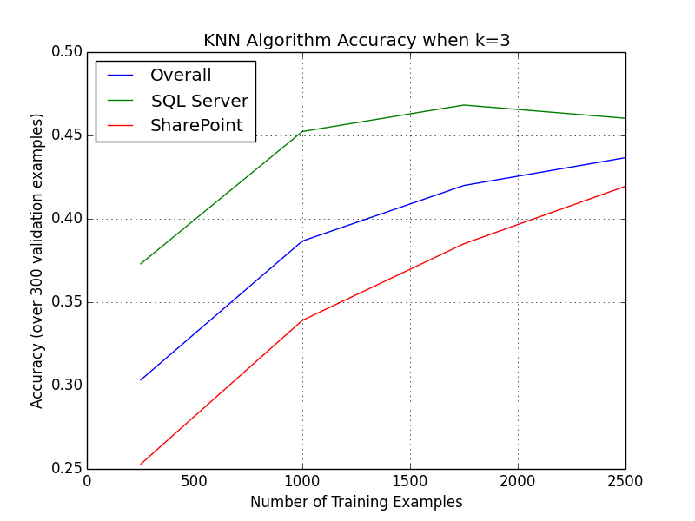
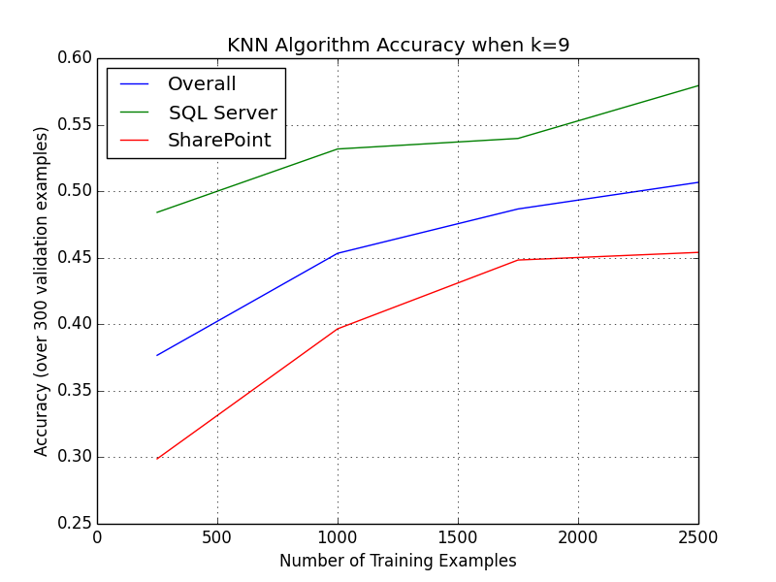
K-Nearest Neighbors
Perhaps zooming in to specific documents, rather than looking at the forum in aggregate will yield better results?
But, what value of k to use?

Slide 15
KNN Results
Using k=9 with 3,000 training examples on a set of 1,000 test examples yields:
Caveats:
VERY slow
Sensitive to choice of k and training data
Doing KNN only within the category identified by the forum category classification algorithm might boost accuracy and speed.
 | SharePoint | SQL Server | Overall
Correct class | 244 | 221 | 465
Incorrect class | 313 | 222 | 535
Accuracy | 43.8% | 49.9% | 46.5%

Slide 16
Finding Most Similar Documents
Given a document, what other document(s) is most similar?
Use case: find existing solutions to a new occurrence of a problem
Using cosine similarity of binary word counts, the results are okay, but not particularly helpful.
Let’s look at an example…

Slide 17
Latent Dirichlet Allocation (LDA)
LDA can help uncover the topics in our text, even when those topics aren’t labeled in some pre-defined way.
Assumptions:
We have k topics.
Each topic has a distribution over all words in the vocabulary.
Each document has a mixture of topics.
For more information about LDA, check out video lectures by David Blei
http://videolectures.net/mlss09uk_blei_tm/
I adapted an LDA model built in Python by Matthew Hoffman for use on my data.
http://www.cs.princeton.edu/~ blei/downloads/onlineldavb.tar

Slide 18
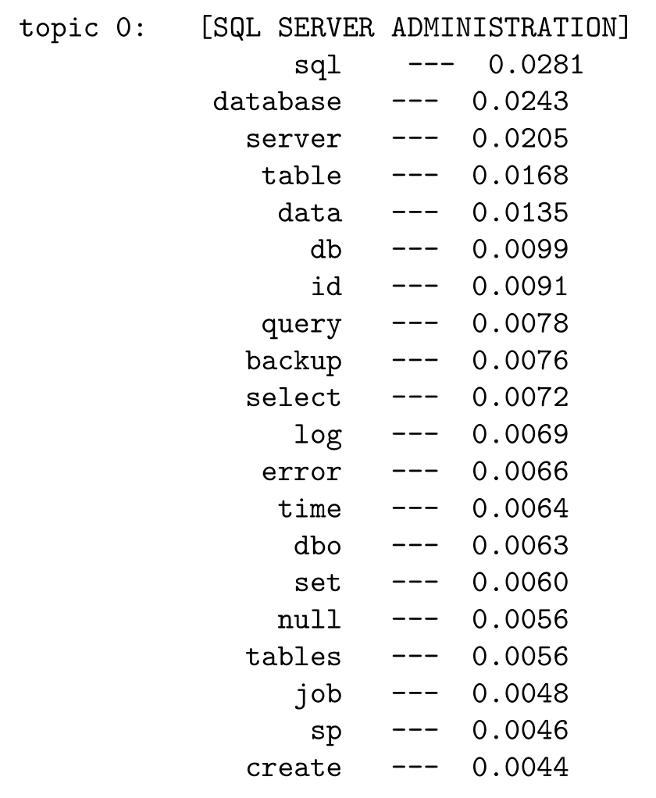
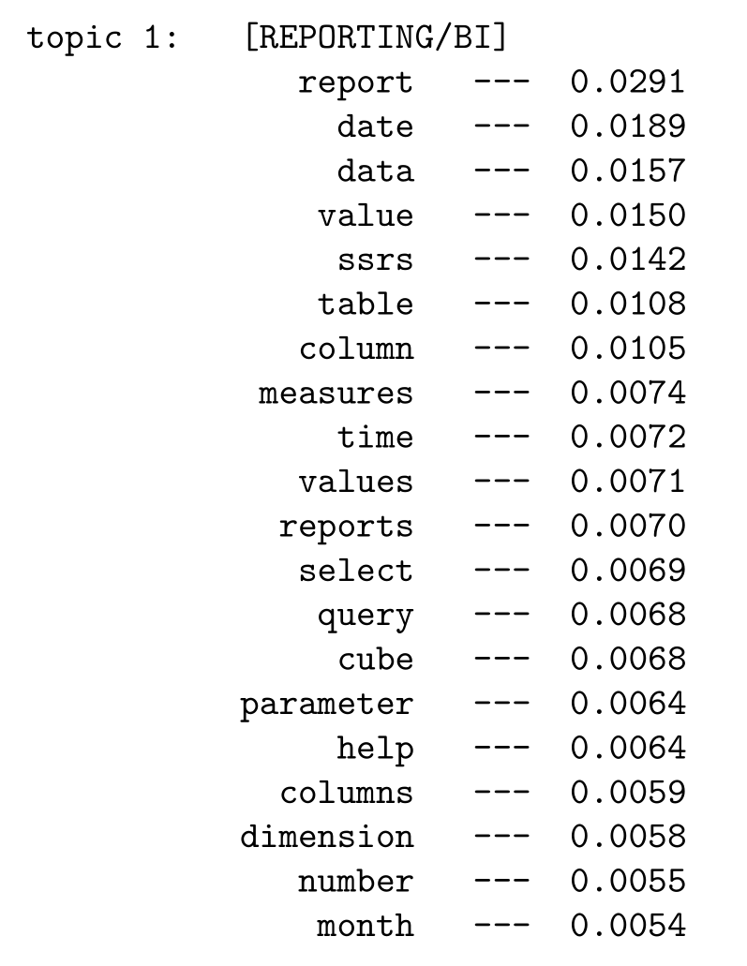
MSDN Latent Topics

Slide 19
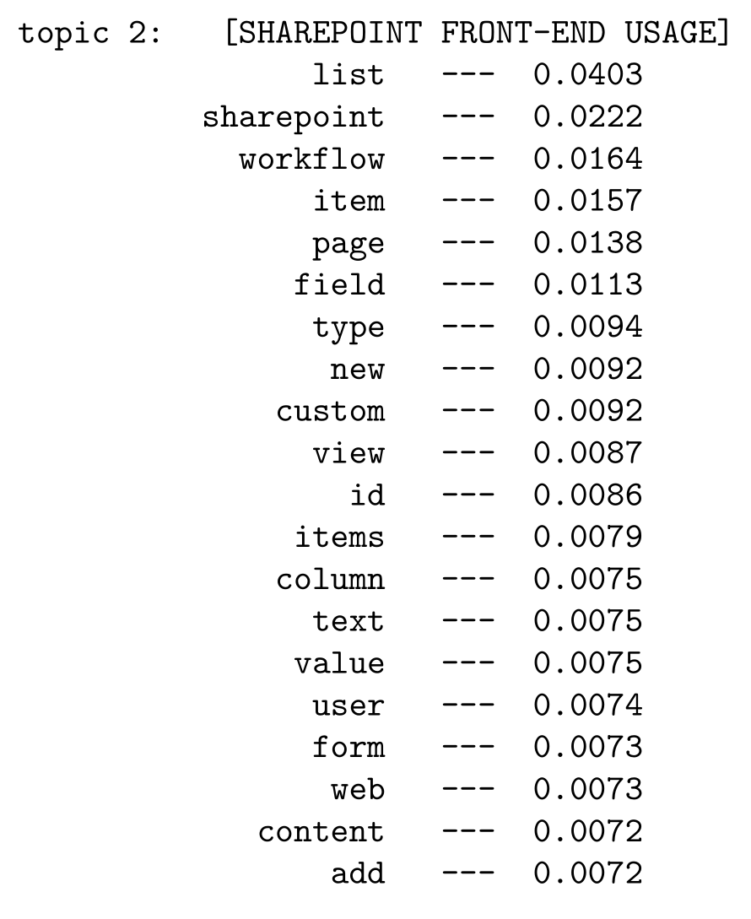
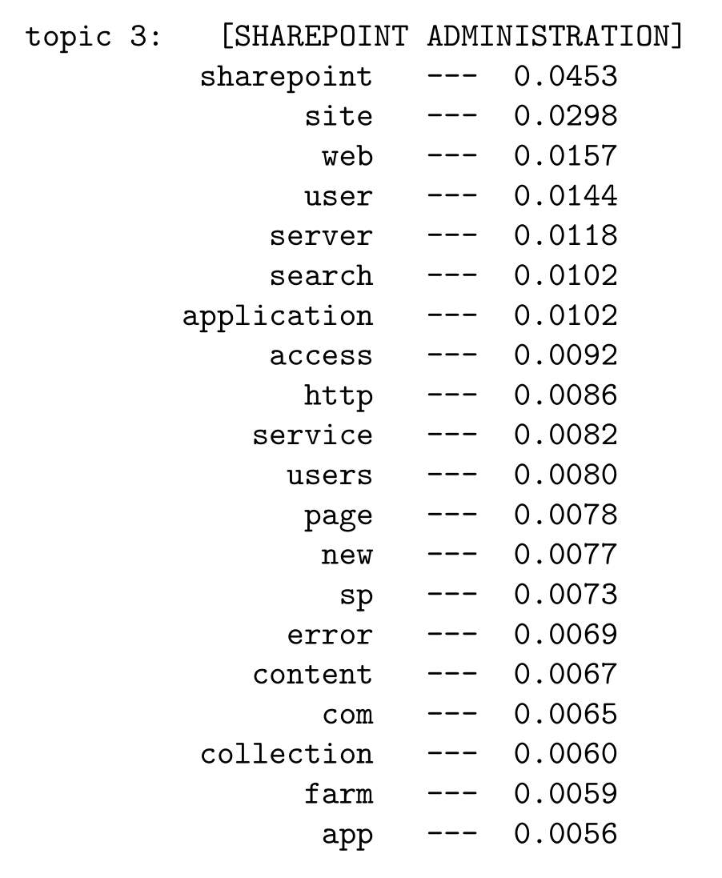
MSDN Latent Topics

